Slide 1


Slide 2

Enhanced solar-regenerated solid desiccant combined with
Breathable wall for direct indoor humidity pumping in hot and
Humid climate
Jihad Jundi, Carl Tamerian, Aya Sabee Ayoun, Maria Naser El Khoury, Mohammad El Mokdad
Advisor & Co-Advisor | Dr. Nessreen Ghaddar & Dr. Kamel Aboughali
MECH 502 Presentation– May 5, 2023
MECH Department | American University of Beirut

Slide 3

Solar-Assisted Passive Dehumidification System
ⓒ All rights reserved. American University of Beirut 2022.
Presentation
Outline:
01.
02.
Introduction
Objectives
03.
04.
Standards and Constraints
Design Iterations
05.
06.
Experimental Protocol
Experimental Results

Slide 4
Solar-Assisted Passive Dehumidification System
ⓒ All rights reserved. American University of Beirut 2022.
1. introduction
1.1 Effects of humidity
Low Humidity (under 30%)
High Humidity (above 50%)
Skin Dryness
Thermal Discomfort
Eye Irritation
Sweat Accumulation
Structural Damage
Indoor Relative Humidity levels should be maintained at 45-60%

Slide 5
Solar-Assisted Passive Dehumidification System
ⓒ All rights reserved. American University of Beirut 2022.
1.2 TYPES OF DEHUMIDIFICATION
Types of Dehumidification
Indirect Dehumidification
Direct Dehumidification
Through condensation
Minimize energy consumption
Energy extensive method
Dehumidifying curtains, desiccant-based dehumidifiers…
Notes:
Conventional is indirect, our system will rely on direct to address problems relating to energy consumption

Slide 6
Solar-Assisted Passive Dehumidification System
Solar-Assisted Passive Dehumidification System
ⓒ All rights reserved. American University of Beirut 2022.
ⓒ All rights reserved. American University of Beirut 2022.
1.3 desiccant-based dehumidification
Solid desiccants are hygroscopic materials that remove moisture from the air when coated on metallic surfaces or fins.
The most common materials include silica gel, zeolites, hygroscopic salts, metal-organic frameworks…
Binders improve heat transfer by increasing the physical contact inside the porous structure.
Dehumidification process:
- Adsorption: The vapor pressure on the desiccant surface is lower than that of the surrounding air → water vapor loosely sticks to the desiccant surface.
- Regeneration: Heat and dry air result in the evaporation of moisture on the desiccant surface.

Slide 7
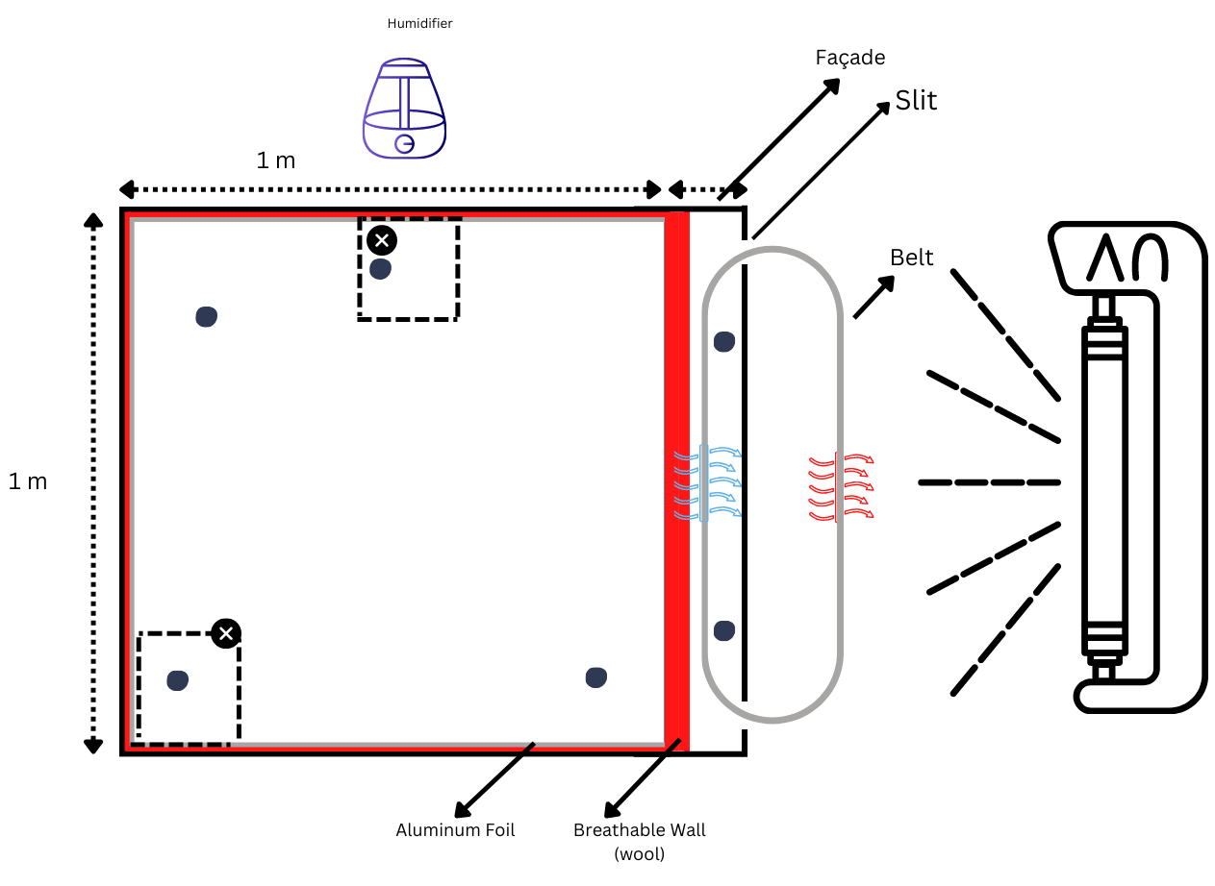
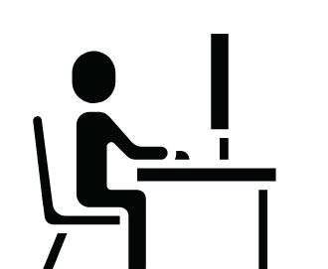
Solar-Assisted Passive Dehumidification System
ⓒ All rights reserved. American University of Beirut 2022.
Breathable Wall
2. Objectives
Solar Lamps
Solar Radiation
Wooden Box
Designing a desiccant-based solar-assisted dehumidification system that pumps humidity from the inside of the façade to the outside environment.
Notes:
The objective of our final project is to construct a dehumidification system and a controlled chamber to test it and validate a numerical model.
The chamber will be a wooden room insulated and secured so that no moisture is lost through the wood.
The dehumidification system will be constructed using a vertical conveyer belt with silica gel coated aluminum sheets.
Solar lamps will also be used in order to allow for the regeneration of the desiccant.
Consequently, we will undergo an experiment in our controlled environment where we measure multiple parameters such as humidity temperature and flow rate in order to compare them with the numerical model.

Slide 8
Solar-Assisted Passive Dehumidification System
ⓒ All rights reserved. American University of Beirut 2022.
Humidifier
Breathable Wall
2. Objectives
Solar Radiation
Wooden Box
The system will consist of a conveyer belt having a breathable wall on one side
and solar radiation on the other.
Notes:
The objective of our final project is to construct a dehumidification system and a controlled chamber to test it and validate a numerical model.
The chamber will be a wooden room insulated and secured so that no moisture is lost through the wood.
The dehumidification system will be constructed using a vertical conveyer belt with silica gel coated aluminum sheets.
Solar lamps will also be used in order to allow for the regeneration of the desiccant.
Consequently, we will undergo an experiment in our controlled environment where we measure multiple parameters such as humidity temperature and flow rate in order to compare them with the numerical model.

Slide 9
Solar-Assisted Passive Dehumidification System
ⓒ All rights reserved. American University of Beirut 2022.
Humidifier
Breathable Wall
2. Objectives
Solar Lamps
Solar Radiation
Wooden Box
The breathable wall will allow moisture to flow to the conveyer belt.
Notes:
The objective of our final project is to construct a dehumidification system and a controlled chamber to test it and validate a numerical model.
The chamber will be a wooden room insulated and secured so that no moisture is lost through the wood.
The dehumidification system will be constructed using a vertical conveyer belt with silica gel coated aluminum sheets.
Solar lamps will also be used in order to allow for the regeneration of the desiccant.
Consequently, we will undergo an experiment in our controlled environment where we measure multiple parameters such as humidity temperature and flow rate in order to compare them with the numerical model.

Slide 10

Solar-Assisted Passive Dehumidification System
ⓒ All rights reserved. American University of Beirut 2022.
Humidifier
Breathable Wall
2. Objectives
Solar Lamps
Solar Radiation
Wooden Box
Silica gel-coated plates will be attached to the conveyer belt.
Notes:
The objective of our final project is to construct a dehumidification system and a controlled chamber to test it and validate a numerical model.
The chamber will be a wooden room insulated and secured so that no moisture is lost through the wood.
The dehumidification system will be constructed using a vertical conveyer belt with silica gel coated aluminum sheets.
Solar lamps will also be used in order to allow for the regeneration of the desiccant.
Consequently, we will undergo an experiment in our controlled environment where we measure multiple parameters such as humidity temperature and flow rate in order to compare them with the numerical model.

Slide 11
Solar-Assisted Passive Dehumidification System
ⓒ All rights reserved. American University of Beirut 2022.
Humidifier
Breathable Wall
2. Objectives
Solar Lamps
Solar Radiation
Wooden Box
The silica gel on these plates will adsorb the moisture on the humid side.
Notes:
The objective of our final project is to construct a dehumidification system and a controlled chamber to test it and validate a numerical model.
The chamber will be a wooden room insulated and secured so that no moisture is lost through the wood.
The dehumidification system will be constructed using a vertical conveyer belt with silica gel coated aluminum sheets.
Solar lamps will also be used in order to allow for the regeneration of the desiccant.
Consequently, we will undergo an experiment in our controlled environment where we measure multiple parameters such as humidity temperature and flow rate in order to compare them with the numerical model.

Slide 12
Solar-Assisted Passive Dehumidification System
ⓒ All rights reserved. American University of Beirut 2022.
Humidifier
Breathable Wall
2. Objectives
Solar Lamps
Solar Radiation
Wooden Box
While on the side of solar radiation, the silica gel will be regenerated through resorption due to the increase in temperature.
Notes:
The objective of our final project is to construct a dehumidification system and a controlled chamber to test it and validate a numerical model.
The chamber will be a wooden room insulated and secured so that no moisture is lost through the wood.
The dehumidification system will be constructed using a vertical conveyer belt with silica gel coated aluminum sheets.
Solar lamps will also be used in order to allow for the regeneration of the desiccant.
Consequently, we will undergo an experiment in our controlled environment where we measure multiple parameters such as humidity temperature and flow rate in order to compare them with the numerical model.

Slide 13
Solar-Assisted Passive Dehumidification System
ⓒ All rights reserved. American University of Beirut 2022.
Humidifier
Breathable Wall
2. Objectives
Solar Lamps
Solar Radiation
Wooden Box
The solar radiation will be produced using solar lamps.
Notes:
The objective of our final project is to construct a dehumidification system and a controlled chamber to test it and validate a numerical model.
The chamber will be a wooden room insulated and secured so that no moisture is lost through the wood.
The dehumidification system will be constructed using a vertical conveyer belt with silica gel coated aluminum sheets.
Solar lamps will also be used in order to allow for the regeneration of the desiccant.
Consequently, we will undergo an experiment in our controlled environment where we measure multiple parameters such as humidity temperature and flow rate in order to compare them with the numerical model.

Slide 14
Solar-Assisted Passive Dehumidification System
ⓒ All rights reserved. American University of Beirut 2022.
Humidifier
Breathable Wall
2. Objectives
Solar Lamps
Solar Radiation
Wooden Box
In order to validate an existing numerical model of this system, a controlled environment is needed to measure the needed parameters.
Notes:
The objective of our final project is to construct a dehumidification system and a controlled chamber to test it and validate a numerical model.
The chamber will be a wooden room insulated and secured so that no moisture is lost through the wood.
The dehumidification system will be constructed using a vertical conveyer belt with silica gel coated aluminum sheets.
Solar lamps will also be used in order to allow for the regeneration of the desiccant.
Consequently, we will undergo an experiment in our controlled environment where we measure multiple parameters such as humidity temperature and flow rate in order to compare them with the numerical model.

Slide 15
Solar-Assisted Passive Dehumidification System
ⓒ All rights reserved. American University of Beirut 2022.
Humidifier
Breathable Wall
2. Objectives
Solar Lamps
Solar Radiation
Wooden Box
Through the rotation of the belt, the process of continuous dehumidification will take place.
Notes:
The objective of our final project is to construct a dehumidification system and a controlled chamber to test it and validate a numerical model.
The chamber will be a wooden room insulated and secured so that no moisture is lost through the wood.
The dehumidification system will be constructed using a vertical conveyer belt with silica gel coated aluminum sheets.
Solar lamps will also be used in order to allow for the regeneration of the desiccant.
Consequently, we will undergo an experiment in our controlled environment where we measure multiple parameters such as humidity temperature and flow rate in order to compare them with the numerical model.

Slide 16
Solar-Assisted Passive Dehumidification System
ⓒ All rights reserved. American University of Beirut 2022.
Humidifier
Breathable Wall
2. Objectives
Solar Lamps
Solar Radiation
Wooden Box
To simulate a human generating moisture in a room, a humidifier was used to pump humidity into the wooden chamber.
Notes:
The objective of our final project is to construct a dehumidification system and a controlled chamber to test it and validate a numerical model.
The chamber will be a wooden room insulated and secured so that no moisture is lost through the wood.
The dehumidification system will be constructed using a vertical conveyer belt with silica gel coated aluminum sheets.
Solar lamps will also be used in order to allow for the regeneration of the desiccant.
Consequently, we will undergo an experiment in our controlled environment where we measure multiple parameters such as humidity temperature and flow rate in order to compare them with the numerical model.

Slide 17
Solar-Assisted Passive Dehumidification System
ⓒ All rights reserved. American University of Beirut 2022.
Humidifier
Breathable Wall
2. Objectives
Solar Lamps
Solar Radiation
Wooden Box
Flow rate, temperature, and humidity sensors will be placed in multiple locations to obtain the needed data to validate the model.
Notes:
The objective of our final project is to construct a dehumidification system and a controlled chamber to test it and validate a numerical model.
The chamber will be a wooden room insulated and secured so that no moisture is lost through the wood.
The dehumidification system will be constructed using a vertical conveyer belt with silica gel coated aluminum sheets.
Solar lamps will also be used in order to allow for the regeneration of the desiccant.
Consequently, we will undergo an experiment in our controlled environment where we measure multiple parameters such as humidity temperature and flow rate in order to compare them with the numerical model.

Slide 18
Solar-Assisted Passive Dehumidification System
ⓒ All rights reserved. American University of Beirut 2022.
3. Standards and constraints
Standards
ASHRAE standard 62.1-2016 “Ventilation for Acceptable Indoor Air Quality”.
Technical constraints
Size of the Lamps: limiting the size of the belt
Non-technical constraints
The time needed for desiccant coating and constructing the system.
ASHRAE 41.1 “Standard Method for Temperature measurement.
ASHRAE MOT standard 139
Air conditioning and Refrigeration Institute Rating standard 940: “Desiccant Dehumidification Components”
Allowed clearance
Insulation thickness and type
Motor speed: 0.27 rpm
Inlet and exhaust air dimensions
Temperature and humidity sensors resolution

Slide 19
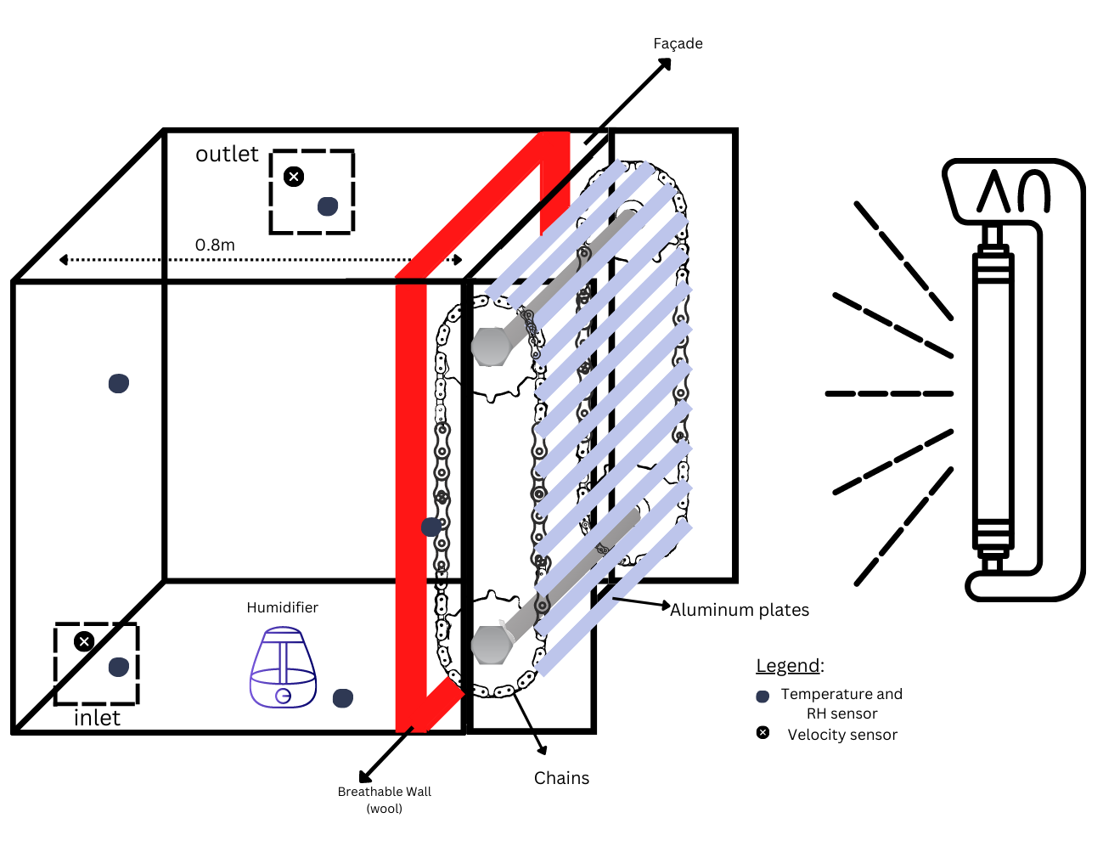
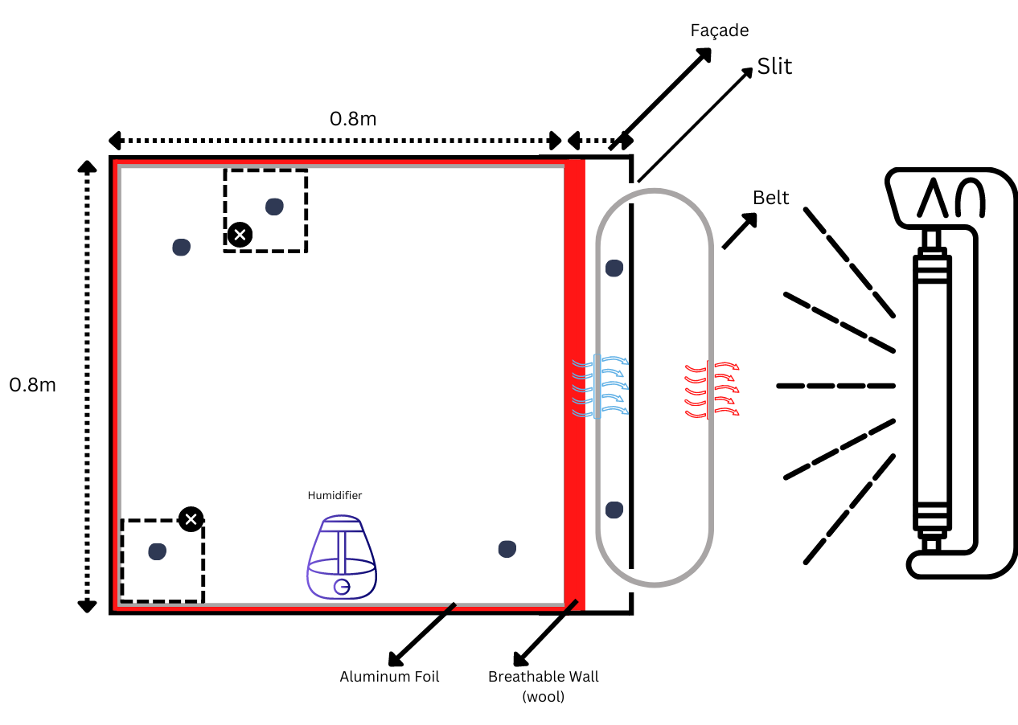
Solar-Assisted Passive Dehumidification System
ⓒ All rights reserved. American University of Beirut 2022.
4. Design Iterations
0.8 m x 0.8 m
4.1 Preliminary DESIGN setup
0.25 m x 0.25 m
Shafts
Mineral Wool
Gears
Figure 2: 2D Side View of the Model
Figure 1: 3D Model
Notes:
Originally the setup consisted of a cubical chamber having sides of 0.8m made of plywood slabs with an air inlet and an outlet located at the opposite side with a side dimension of 0.25 m. Five of its inner walls will be covered with a layer of fiberglass insulation with an additional layer of aluminum foil wrapped around to prevent the absorption of moisture and humidity. The rotating belt mechanism will consist of chains rotating on gears mounted on 2 shafts to which the aluminum plates coated with silica gel will be attached. This belt mechanism will be inserted inside a smaller wood chamber (serving as the facade) and will be subjected to solar radiation from the solar lamps rated 1000W. A breathable wall is inserted in the facade, made up of mineral wool, to allow moisture transfer between the facade and the larger chamber. And finally, a humidifier is placed inside the chamber to maintain a constant relative humidity level.

Slide 20
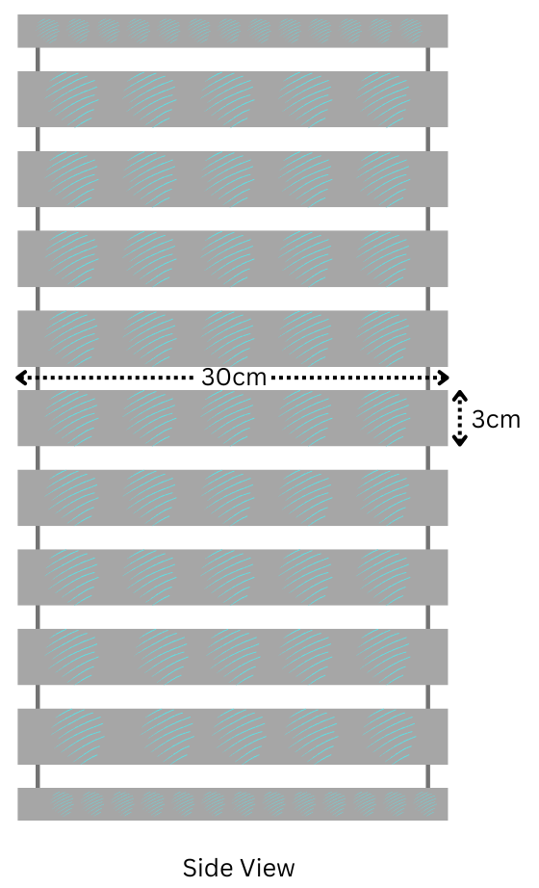
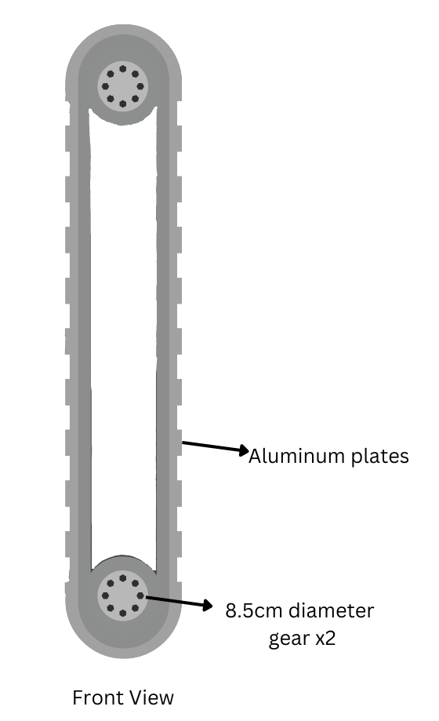
Solar-Assisted Passive Dehumidification System
ⓒ All rights reserved. American University of Beirut 2022.
4.1 System description
BELT VIEWS
Chain with thickness 3mm
4 Gears with 8.5cm diameter
40 silica gel coated plates
Figure 3:
Figure 4:
Notes:
The belt will consist of 4 gears each having a diameter of 8.5cm and 2 chains of a thickness of approximately 3mm. 40 aluminum sheets each having a size of (0.3mx0.03m) will be drilled on both ends to be fixed onto the chains.

Slide 21
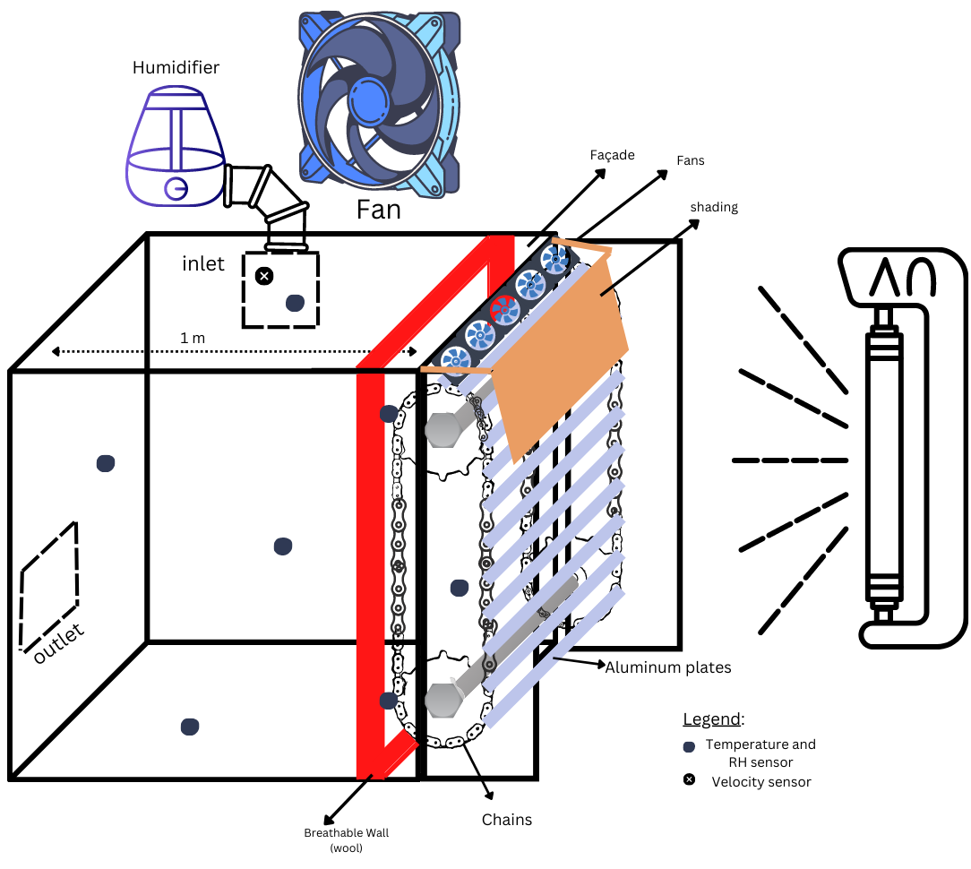
Solar-Assisted Passive Dehumidification System
ⓒ All rights reserved. American University of Beirut 2022.
4.2 Iterations
1
Chamber
1x1x1m
Figure 5: 3D View of the Final System
Notes:
This setup however underwent several iterations in order to reach the final one. Starting with the chamber whose dimensions were changed to have a side of 1m.

Slide 22
Solar-Assisted Passive Dehumidification System
ⓒ All rights reserved. American University of Beirut 2022.
4.2 Iterations
Shading
Shading
2
Cooling and Shading
Figure 5: 3D View of the Final System
Notes:
A shading section was added on the regeneration side since the regeneration time is shorter than the dehumidification time which causes a high increase in the desiccant's temperature. The shading blocks the solar radiation emitted from the lamps and thus the desiccant is cooled through natural convection to a desired temperature.

Slide 23
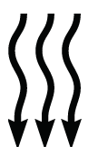
Solar-Assisted Passive Dehumidification System
ⓒ All rights reserved. American University of Beirut 2022.
4.2 Iterations
Array of 12 Fans
Shading
2
Cooling and Shading
Figure 5: 3D View of the Final System
Notes:
However, after some experimentation, we found that the natural convection was not enough to induce the desired cooling effect in the shading region; therefore, an array of 12 fans was installed at the top of this region to help with the cooling process by convection.

Slide 24
Solar-Assisted Passive Dehumidification System
ⓒ All rights reserved. American University of Beirut 2022.
4.2 Iterations
Gear Box
Shading
3
Gears
Figure 5: 3D View of the Final System
Notes:
The sizes of the gears chosen previously (D=8.5 cm) wouldn’t allow us to get the desired rotational speed with the available motor which has a rotational speed of 10 rpm. This is greater than the desired speed that should fall within the range of 0.27 to 0.35, so we had to come up with new solutions. In order to decrease the final rotational speed, a gear train had to be implemented.

Slide 25
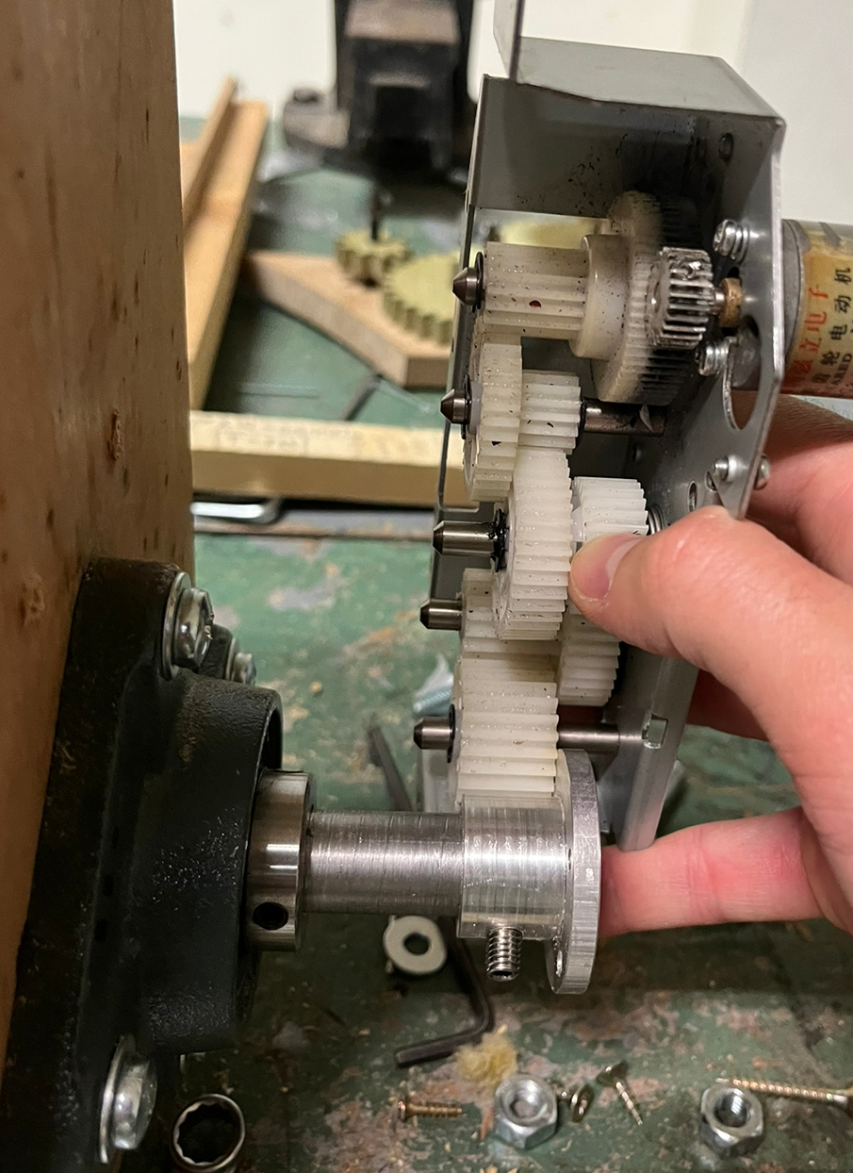
Solar-Assisted Passive Dehumidification System
ⓒ All rights reserved. American University of Beirut 2022.
4.2 Iterations
3
Gears
Gear Box
Figure 6: Gear Box
Notes:
This pre-assembled gearbox was mounted on the shaft’s axe to reduce the rotational speed from 10 rpm to 0.27 rpm by using a 10:60 gear ratio.

Slide 26
Solar-Assisted Passive Dehumidification System
Humidifier
ⓒ All rights reserved. American University of Beirut 2022.
4.2 Iterations
4
Humidifier and Fan
Figure 5: 3D View of the Final System
Notes:
To ensure a steady and continuous flow of humidity inside the chamber, the humidifier was placed at the inlet of the chamber.
This eliminates the risk of the humidifier turning off once the desired humidity level is reached which might lead to uneven humidity levels, as it may take longer for the moisture to be diffused throughout the entire chamber.

Slide 27
Solar-Assisted Passive Dehumidification System
Fan
ⓒ All rights reserved. American University of Beirut 2022.
4.2 Iterations
4
Humidifier and Fan
Figure 5: 3D View of the Final System
Notes:
A large fan is used to facilitate the diffusion of moisture into the chamber, which ensures that the humidity levels are evenly distributed.

Slide 28
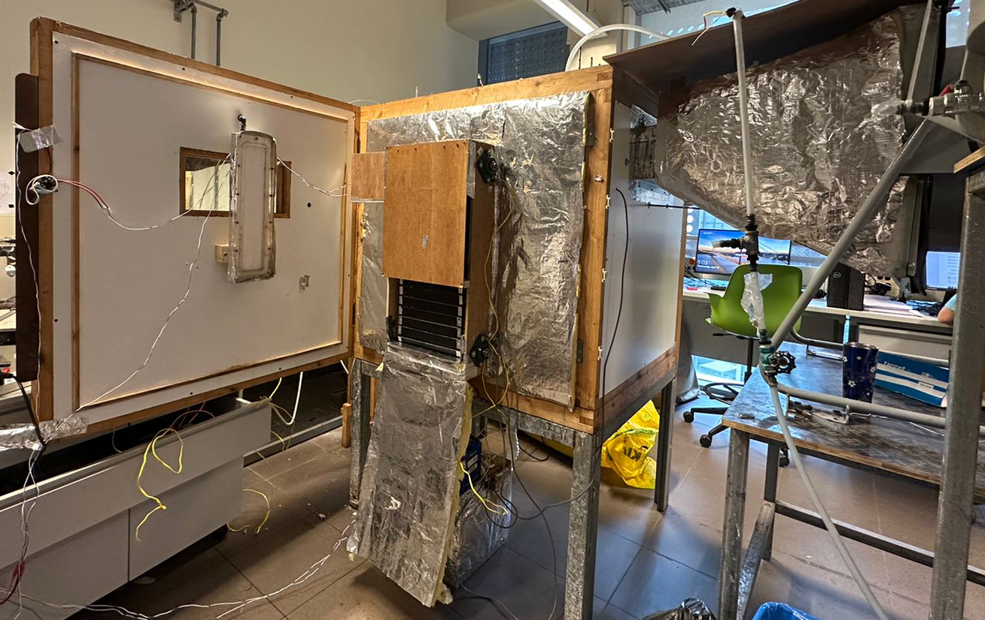
Solar-Assisted Passive Dehumidification System
ⓒ All rights reserved. American University of Beirut 2022.
4.3 implemented setup
Notes:
After all of these iterations were implemented, we ended up having this system built as our final setup.

Slide 29
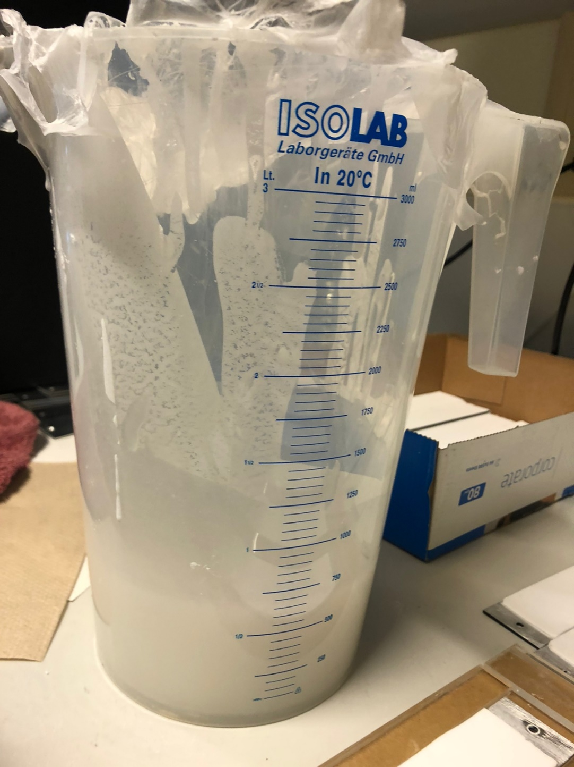
Solar-Assisted Passive Dehumidification System
ⓒ All rights reserved. American University of Beirut 2022.
5. Experimental protocol
0.8 m x 0.8 m
5.1 Coatings
1
Mixture
Silica Coating Mixture
3g HEC
97g silica
300ml H2O
Figure 7: Silica Coating Mixture
Notes:
The experimental protocol is divided into two sections: the coating of the desiccant and the experiment. To prepare the silica coating solution HEC (hydroxyethyl cellulose) was dissolved in water followed by the addition of the silica powder according to the following ratio: 3g HEC / 97g silica / 300ml H2O.

Slide 30
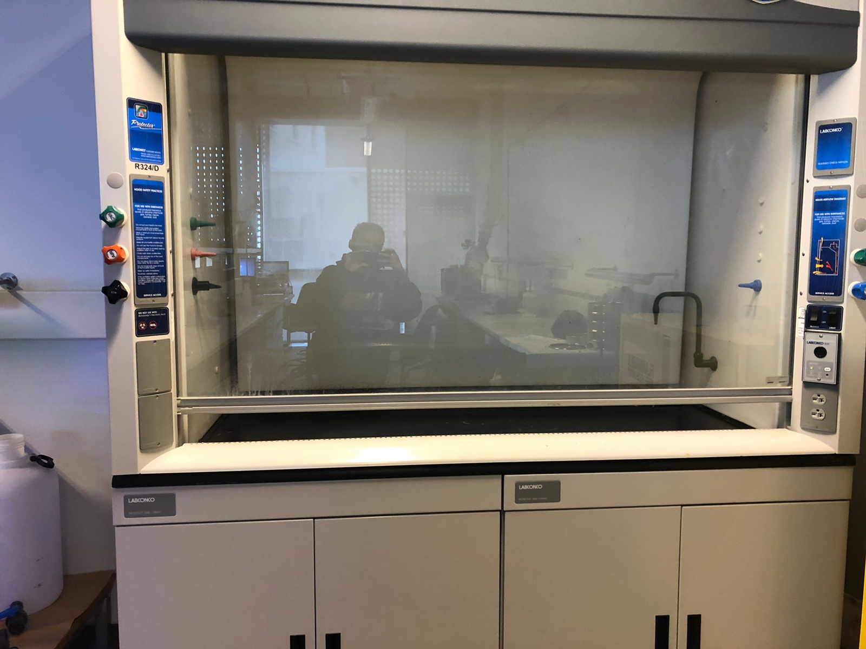
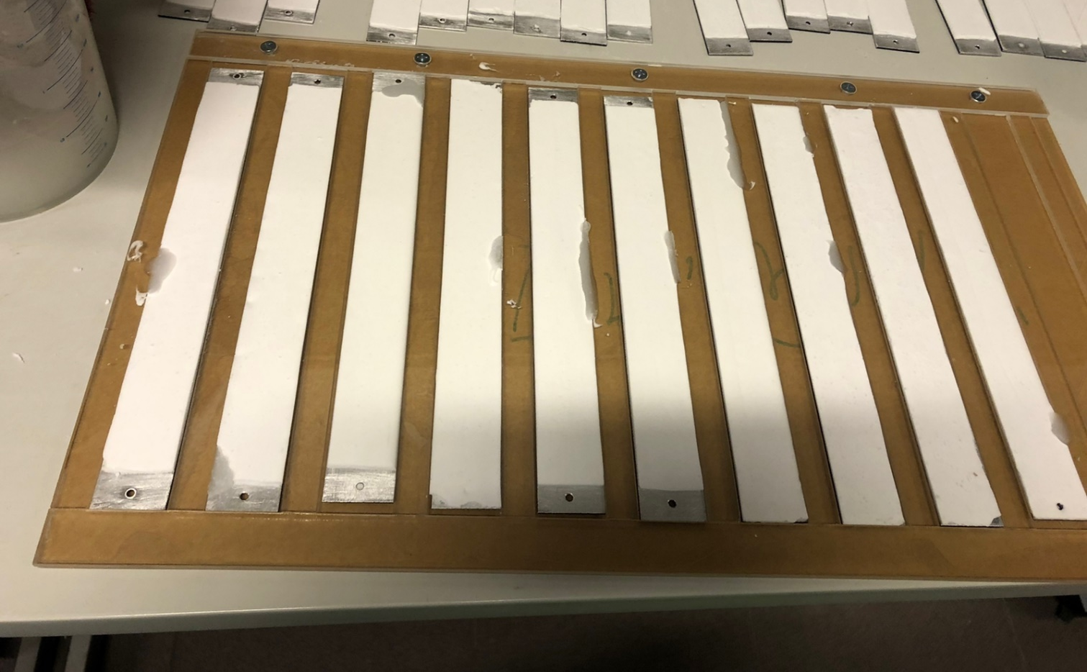
Solar-Assisted Passive Dehumidification System
ⓒ All rights reserved. American University of Beirut 2022.
5. Experimental protocol
0.8 m x 0.8 m
5.1 Coatings
2
Coating Procedure
Figure 8: Mold Structure
Figure 9: Fume Room
Molding Structure
Fume Room
Notes:
To be able to coat the plates, a mold structure was prepared that had a thickness of 2 mm with an error margin. The coating was done inside a laboratory fume hood shown in Figure - which prevents the release of hazardous substances into the laboratory. The procedure went as follows: Etching was first done vertically along the whole length of the plate, horizontally and then finally in circular hand movements, the plates were then coated by using syringes. After around 20-30 minutes, the mixture would have dried out and the plates were removed from the mold to make room for another batch.

Slide 31
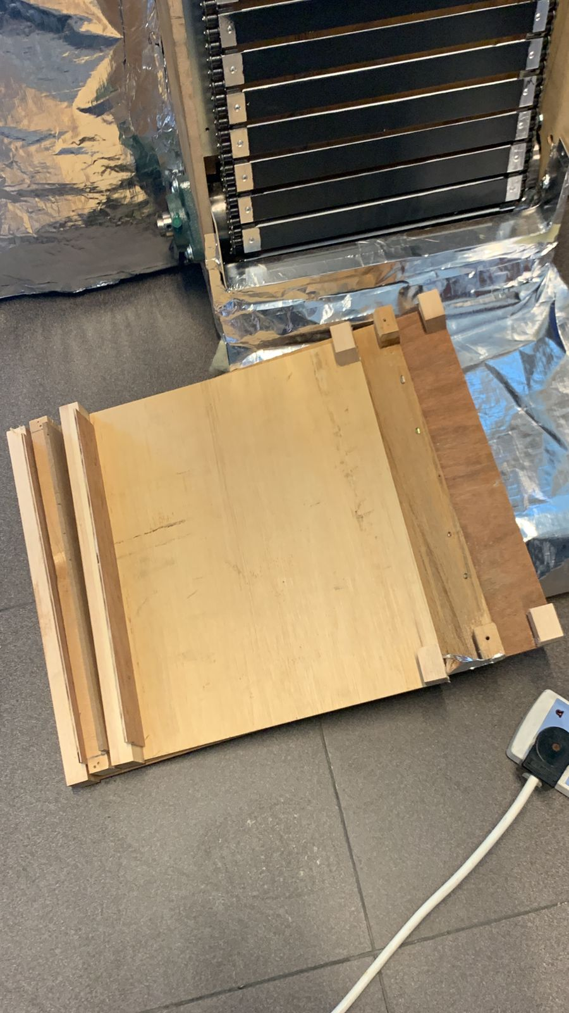
Solar-Assisted Passive Dehumidification System
ⓒ All rights reserved. American University of Beirut 2022.
5. Experimental protocol
0.8 m x 0.8 m
Different shading levels
5.2 Experiment
1
Conditions
40% Shading
450 W
700 W
60% Shading
450 W
700 W
Figure 10: Different Shading Levels
50% Shading
450 W
700 W
Notes:
As for the experiment was conducted several times by changing the solar intensity and the shading applied To simulate different variable conditions that might arise in a real life setting,. By fixing the percentage of shading imposed on the system, the intensity was varied between two values: 450 and 700 W. After running the experiment at each intensity, the level of shading was increased, starting with 40 % then 50 % and finally 60 % shading

Slide 32
Solar-Assisted Passive Dehumidification System
ⓒ All rights reserved. American University of Beirut 2022.
5. Experimental protocol
0.8 m x 0.8 m
5.2 Experiment
Wait for steady state of belt and room conditions
Remove Aluminum Sheet
Wait for humidity drop to stabilize
Turn on and adjust equipment
2
Procedure
Notes:
To start the experiment, the belt, the solar lamps, the DAQ system, the fan and the humidifier were turned on. The lamps were then adjusted to emit the desired intensity (which can be monitored through the sensor shown in figure -), the speed of the fan to run at the desired speed (through a control notch) and the humidifier to provide the necessary humidity level. During this stage of the experiment an aluminum sheet was put as a barrier between the belt and the inner section of the room to ensure steady state of the belt and the room before allowing the dehumidification to take place.
To determine whether the belt reached steady state, using an infrared thermometer the temperature of the desiccant was measured at the three locations (as soon as it is exposed to the intensity, before the shading in the middle where it achieves the highest temperature , and before it goes through the cooling stage). These temperatures were monitored every five minutes until they stopped alternating between two consecutive iterations. In parallel, the relative humidity of the room was also monitored every five minutes until it stabilizes at a certain level. Measurements were taken while monitoring for future data analysis.
After steady state was reached, the aluminum sheet was removed carefully by slightly opening the door of the chamber and sliding it from the top.
Then, as the dehumidification process was taking place, the relative humidity and dry bulb temperature were monitored through the DAQ (seen in figure) every five minutes till it reaches a steady state

Slide 33
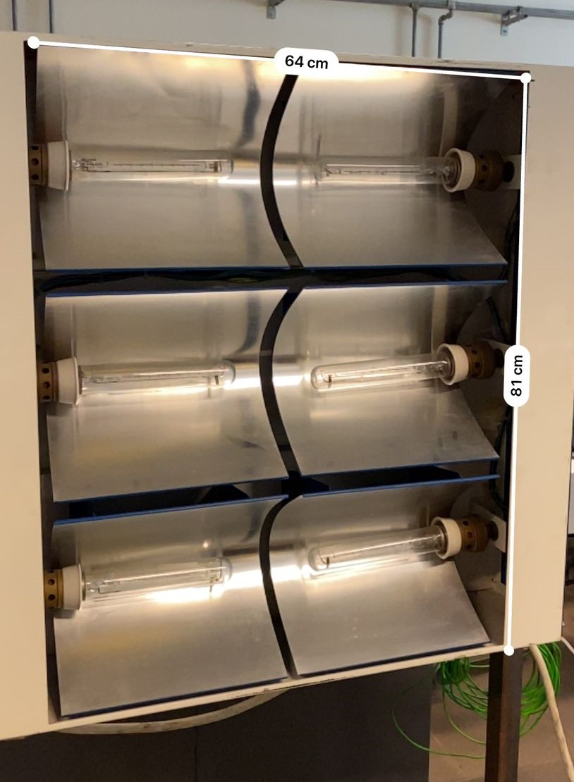
Solar-Assisted Passive Dehumidification System
ⓒ All rights reserved. American University of Beirut 2022.
5. Experimental protocol
0.8 m x 0.8 m
5.2 Experiment
Turn on and adjust equipment
Figure 11: Solar Lamps
Notes:
To start the experiment, the belt, the solar lamps, the DAQ system, the fan and the humidifier were turned on. The lamps were then adjusted to emit the desired intensity (which can be monitored through the sensor shown in figure -), the speed of the fan to run at the desired speed (through a control notch) and the humidifier to provide the necessary humidity level. During this stage of the experiment an aluminum sheet was put as a barrier between the belt and the inner section of the room to ensure steady state of the belt and the room before allowing the dehumidification to take place.
To determine whether the belt reached steady state, using an infrared thermometer the temperature of the desiccant was measured at the three locations (as soon as it is exposed to the intensity, before the shading in the middle where it achieves the highest temperature , and before it goes through the cooling stage). These temperatures were monitored every five minutes until they stopped alternating between two consecutive iterations. In parallel, the relative humidity of the room was also monitored every five minutes until it stabilizes at a certain level. Measurements were taken while monitoring for future data analysis.
After steady state was reached, the aluminum sheet was removed carefully by slightly opening the door of the chamber and sliding it from the top.
Then, as the dehumidification process was taking place, the relative humidity and dry bulb temperature were monitored through the DAQ (seen in figure) every five minutes till it reaches a steady state

Slide 34
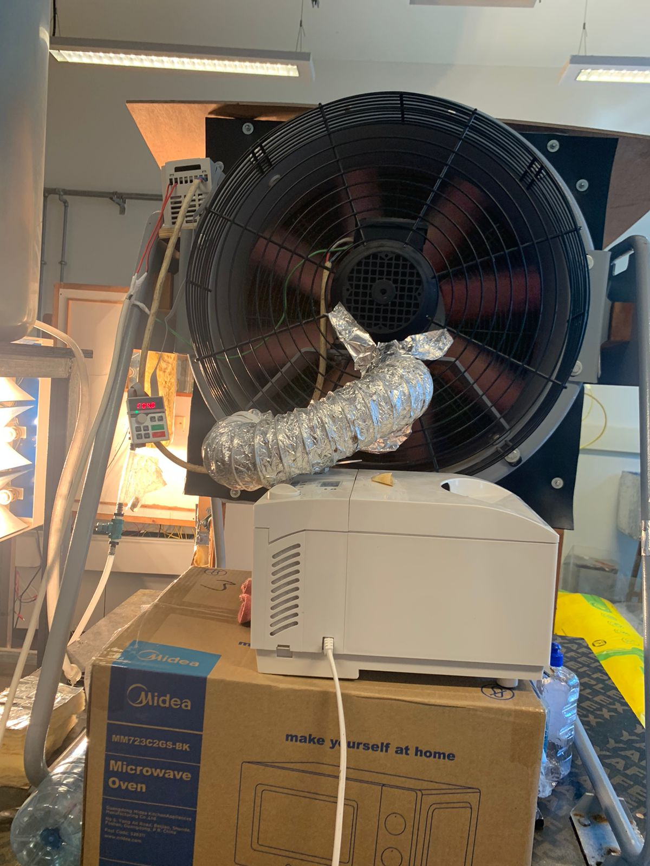
Solar-Assisted Passive Dehumidification System
ⓒ All rights reserved. American University of Beirut 2022.
5. Experimental protocol
0.8 m x 0.8 m
5.2 Experiment
Turn on and adjust equipment
Figure 12: Fan + Humidifier
Notes:
To start the experiment, the belt, the solar lamps, the DAQ system, the fan and the humidifier were turned on. The lamps were then adjusted to emit the desired intensity (which can be monitored through the sensor shown in figure -), the speed of the fan to run at the desired speed (through a control notch) and the humidifier to provide the necessary humidity level. During this stage of the experiment an aluminum sheet was put as a barrier between the belt and the inner section of the room to ensure steady state of the belt and the room before allowing the dehumidification to take place.
To determine whether the belt reached steady state, using an infrared thermometer the temperature of the desiccant was measured at the three locations (as soon as it is exposed to the intensity, before the shading in the middle where it achieves the highest temperature , and before it goes through the cooling stage). These temperatures were monitored every five minutes until they stopped alternating between two consecutive iterations. In parallel, the relative humidity of the room was also monitored every five minutes until it stabilizes at a certain level. Measurements were taken while monitoring for future data analysis.
After steady state was reached, the aluminum sheet was removed carefully by slightly opening the door of the chamber and sliding it from the top.
Then, as the dehumidification process was taking place, the relative humidity and dry bulb temperature were monitored through the DAQ (seen in figure) every five minutes till it reaches a steady state

Slide 35
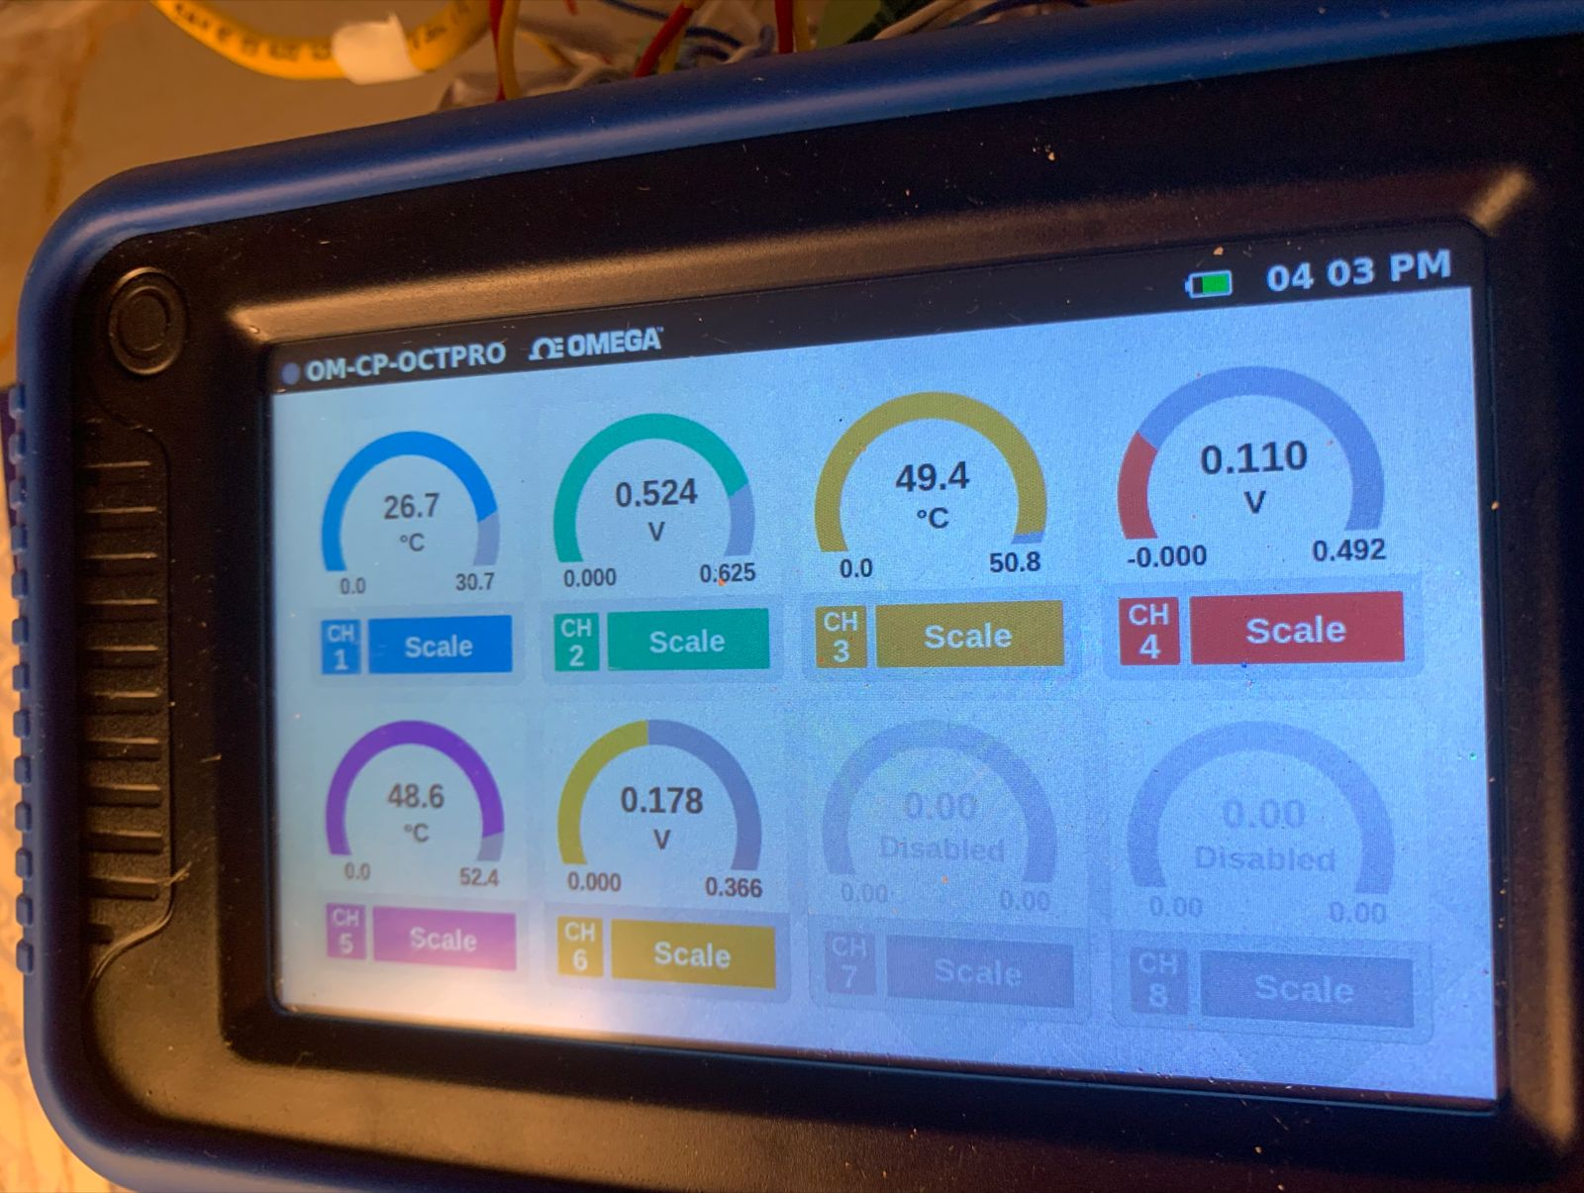
Solar-Assisted Passive Dehumidification System
ⓒ All rights reserved. American University of Beirut 2022.
5. Experimental protocol
0.8 m x 0.8 m
5.2 Experiment
Turn on and adjust equipment
Figure 13: DAQ
Notes:
To start the experiment, the belt, the solar lamps, the DAQ system, the fan and the humidifier were turned on. The lamps were then adjusted to emit the desired intensity (which can be monitored through the sensor shown in figure -), the speed of the fan to run at the desired speed (through a control notch) and the humidifier to provide the necessary humidity level. During this stage of the experiment an aluminum sheet was put as a barrier between the belt and the inner section of the room to ensure steady state of the belt and the room before allowing the dehumidification to take place.
To determine whether the belt reached steady state, using an infrared thermometer the temperature of the desiccant was measured at the three locations (as soon as it is exposed to the intensity, before the shading in the middle where it achieves the highest temperature , and before it goes through the cooling stage). These temperatures were monitored every five minutes until they stopped alternating between two consecutive iterations. In parallel, the relative humidity of the room was also monitored every five minutes until it stabilizes at a certain level. Measurements were taken while monitoring for future data analysis.
After steady state was reached, the aluminum sheet was removed carefully by slightly opening the door of the chamber and sliding it from the top.
Then, as the dehumidification process was taking place, the relative humidity and dry bulb temperature were monitored through the DAQ (seen in figure) every five minutes till it reaches a steady state

Slide 36
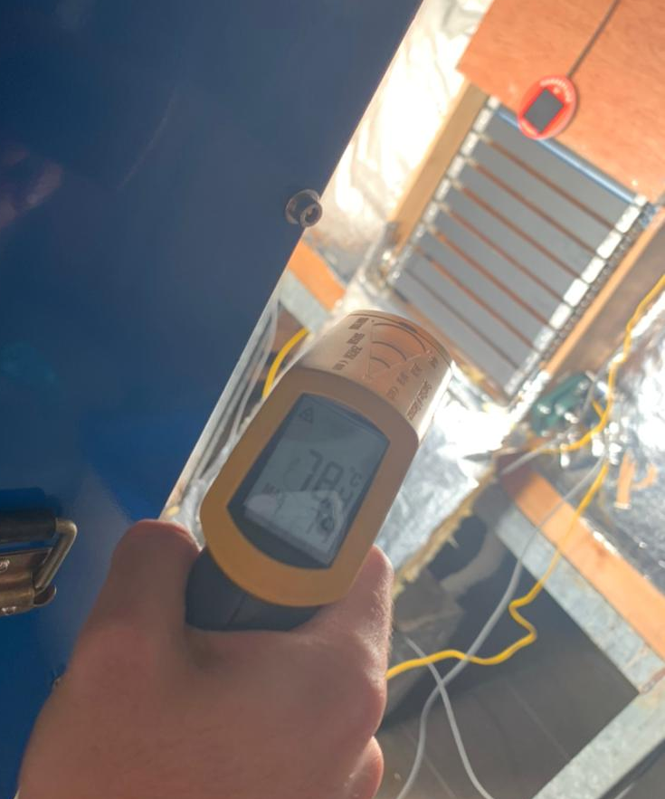
Solar-Assisted Passive Dehumidification System
ⓒ All rights reserved. American University of Beirut 2022.
5. Experimental protocol
0.8 m x 0.8 m
5.2 Experiment
Turn on and adjust equipment
Wait for the steady state of the belt and room conditions
Figure 14: Infrared Thermometer
Notes:
To start the experiment, the belt, the solar lamps, the DAQ system, the fan and the humidifier were turned on. The lamps were then adjusted to emit the desired intensity (which can be monitored through the sensor), the speed of the fan to run at the desired speed (through a control notch) and the humidifier to provide the necessary humidity level. During this stage of the experiment an aluminum sheet was put as a barrier between the belt and the inner section of the room to ensure steady state of the belt and the room before allowing the dehumidification to take place.
To determine whether the belt reached steady state, using an infrared thermometer the temperature of the desiccant was measured at the three locations (as soon as it is exposed to the intensity, before the shading in the middle where it achieves the highest temperature , and before it goes through the cooling stage). These temperatures were monitored every five minutes until they stopped alternating between two consecutive iterations. In parallel, the relative humidity of the room was also monitored every five minutes until it stabilizes at a certain level. Measurements were taken while monitoring for future data analysis.
After steady state was reached, the aluminum sheet was removed carefully by slightly opening the door of the chamber and sliding it from the top.
Then, as the dehumidification process was taking place, the relative humidity and dry bulb temperature were monitored through the DAQ (seen in figure) every five minutes till it reaches a steady state

Slide 37
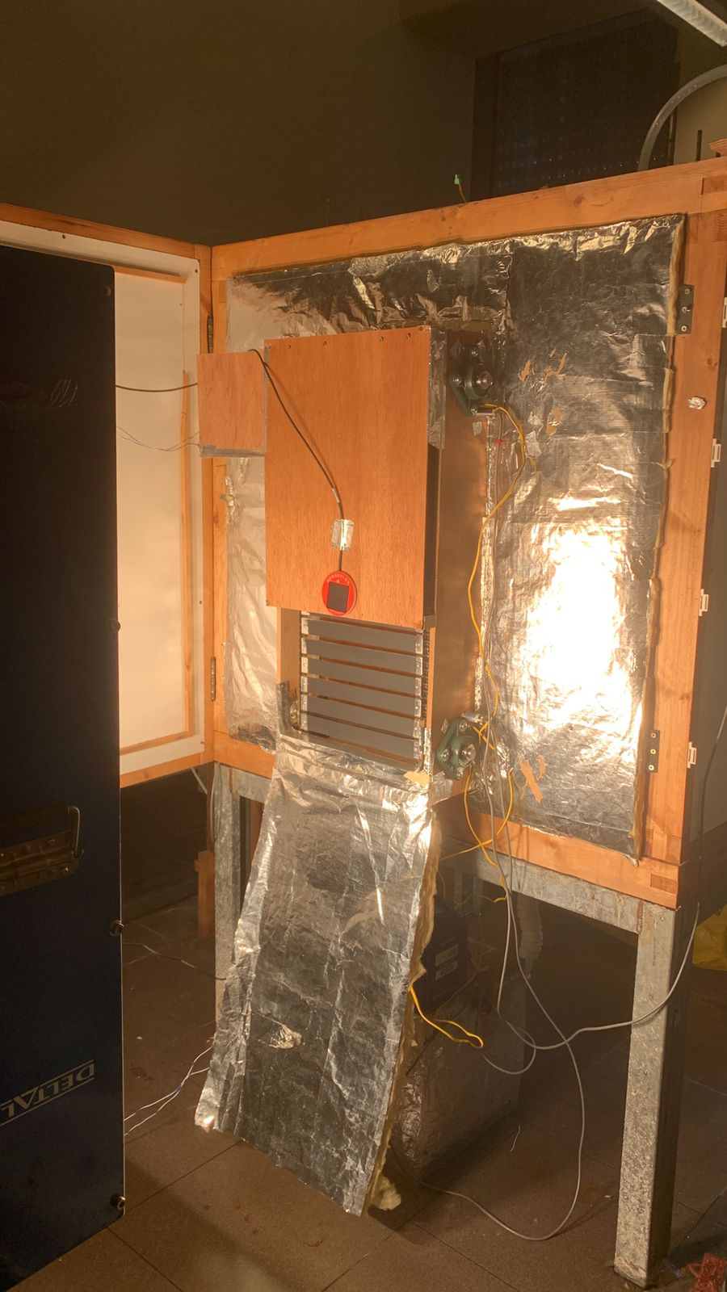
Solar-Assisted Passive Dehumidification System
ⓒ All rights reserved. American University of Beirut 2022.
5. Experimental protocol
0.8 m x 0.8 m
5.2 Experiment
Turn on and adjust equipment
Wait for the steady state of the belt and room conditions
Figure 15: Belt System
Notes:
To start the experiment, the belt, the solar lamps, the DAQ system, the fan and the humidifier were turned on. The lamps were then adjusted to emit the desired intensity (which can be monitored through the sensor shown in figure -), the speed of the fan to run at the desired speed (through a control notch) and the humidifier to provide the necessary humidity level. During this stage of the experiment an aluminum sheet was put as a barrier between the belt and the inner section of the room to ensure steady state of the belt and the room before allowing the dehumidification to take place.
To determine whether the belt reached steady state, using an infrared thermometer the temperature of the desiccant was measured at the three locations (as soon as it is exposed to the intensity, before the shading in the middle where it achieves the highest temperature , and before it goes through the cooling stage). These temperatures were monitored every five minutes until they stopped alternating between two consecutive iterations. In parallel, the relative humidity of the room was also monitored every five minutes until it stabilizes at a certain level. Measurements were taken while monitoring for future data analysis.
After steady state was reached, the aluminum sheet was removed carefully by slightly opening the door of the chamber and sliding it from the top.
Then, as the dehumidification process was taking place, the relative humidity and dry bulb temperature were monitored through the DAQ (seen in figure) every five minutes till it reaches a steady state

Slide 38
Solar-Assisted Passive Dehumidification System
ⓒ All rights reserved. American University of Beirut 2022.
5. Experimental protocol
0.8 m x 0.8 m
5.2 Experiment
Turn on and adjust equipment
Wait for the steady state of the belt and room conditions
Figure 15: Belt System
Notes:
To start the experiment, the belt, the solar lamps, the DAQ system, the fan and the humidifier were turned on. The lamps were then adjusted to emit the desired intensity (which can be monitored through the sensor shown in figure -), the speed of the fan to run at the desired speed (through a control notch) and the humidifier to provide the necessary humidity level. During this stage of the experiment an aluminum sheet was put as a barrier between the belt and the inner section of the room to ensure steady state of the belt and the room before allowing the dehumidification to take place.
To determine whether the belt reached steady state, using an infrared thermometer the temperature of the desiccant was measured at the three locations (as soon as it is exposed to the intensity, before the shading in the middle where it achieves the highest temperature , and before it goes through the cooling stage). These temperatures were monitored every five minutes until they stopped alternating between two consecutive iterations. In parallel, the relative humidity of the room was also monitored every five minutes until it stabilizes at a certain level. Measurements were taken while monitoring for future data analysis.
After steady state was reached, the aluminum sheet was removed carefully by slightly opening the door of the chamber and sliding it from the top.
Then, as the dehumidification process was taking place, the relative humidity and dry bulb temperature were monitored through the DAQ (seen in figure) every five minutes till it reaches a steady state

Slide 39
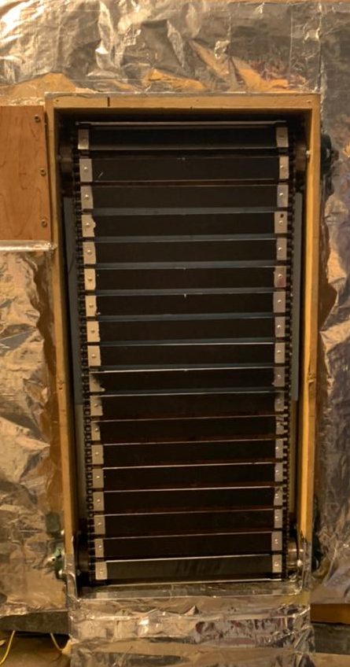
Solar-Assisted Passive Dehumidification System
ⓒ All rights reserved. American University of Beirut 2022.
5. Experimental protocol
0.8 m x 0.8 m
5.2 Experiment
Turn on and adjust equipment
Wait for the steady state of the belt and room conditions
Figure 15: Belt System
Notes:
To start the experiment, the belt, the solar lamps, the DAQ system, the fan and the humidifier were turned on. The lamps were then adjusted to emit the desired intensity (which can be monitored through the sensor shown in figure -), the speed of the fan to run at the desired speed (through a control notch) and the humidifier to provide the necessary humidity level. During this stage of the experiment an aluminum sheet was put as a barrier between the belt and the inner section of the room to ensure steady state of the belt and the room before allowing the dehumidification to take place.
To determine whether the belt reached steady state, using an infrared thermometer the temperature of the desiccant was measured at the three locations (as soon as it is exposed to the intensity, before the shading in the middle where it achieves the highest temperature , and before it goes through the cooling stage). These temperatures were monitored every five minutes until they stopped alternating between two consecutive iterations. In parallel, the relative humidity of the room was also monitored every five minutes until it stabilizes at a certain level. Measurements were taken while monitoring for future data analysis.
After steady state was reached, the aluminum sheet was removed carefully by slightly opening the door of the chamber and sliding it from the top.
Then, as the dehumidification process was taking place, the relative humidity and dry bulb temperature were monitored through the DAQ (seen in figure) every five minutes till it reaches a steady state

Slide 40
Solar-Assisted Passive Dehumidification System
ⓒ All rights reserved. American University of Beirut 2022.
5. Experimental protocol
0.8 m x 0.8 m
5.2 Experiment
Turn on and adjust equipment
Wait for steady state of belt and room conditions
Remove Aluminum Sheet
Figure 16: Aluminum Sheet
Notes:
To start the experiment, the belt, the solar lamps, the DAQ system, the fan and the humidifier were turned on. The lamps were then adjusted to emit the desired intensity (which can be monitored through the sensor shown in figure -), the speed of the fan to run at the desired speed (through a control notch) and the humidifier to provide the necessary humidity level. During this stage of the experiment an aluminum sheet was put as a barrier between the belt and the inner section of the room to ensure steady state of the belt and the room before allowing the dehumidification to take place.
To determine whether the belt reached steady state, using an infrared thermometer the temperature of the desiccant was measured at the three locations (as soon as it is exposed to the intensity, before the shading in the middle where it achieves the highest temperature , and before it goes through the cooling stage). These temperatures were monitored every five minutes until they stopped alternating between two consecutive iterations. In parallel, the relative humidity of the room was also monitored every five minutes until it stabilizes at a certain level. Measurements were taken while monitoring for future data analysis.
After steady state was reached, the aluminum sheet was removed carefully by slightly opening the door of the chamber and sliding it from the top.
Then, as the dehumidification process was taking place, the relative humidity and dry bulb temperature were monitored through the DAQ (seen in figure) every five minutes till it reaches a steady state

Slide 41
Solar-Assisted Passive Dehumidification System
ⓒ All rights reserved. American University of Beirut 2022.
5. Experimental protocol
0.8 m x 0.8 m
5.2 Experiment
Turn on and adjust equipment
Wait for steady state of belt and room conditions
Remove Aluminum Sheet
Wait for humidity drop to stabilize
Notes:
To start the experiment, the belt, the solar lamps, the DAQ system, the fan and the humidifier were turned on. The lamps were then adjusted to emit the desired intensity (which can be monitored through the sensor shown in figure -), the speed of the fan to run at the desired speed (through a control notch) and the humidifier to provide the necessary humidity level. During this stage of the experiment an aluminum sheet was put as a barrier between the belt and the inner section of the room to ensure steady state of the belt and the room before allowing the dehumidification to take place.
To determine whether the belt reached steady state, using an infrared thermometer the temperature of the desiccant was measured at the three locations (as soon as it is exposed to the intensity, before the shading in the middle where it achieves the highest temperature , and before it goes through the cooling stage). These temperatures were monitored every five minutes until they stopped alternating between two consecutive iterations. In parallel, the relative humidity of the room was also monitored every five minutes until it stabilizes at a certain level. Measurements were taken while monitoring for future data analysis.
After steady state was reached, the aluminum sheet was removed carefully by slightly opening the door of the chamber and sliding it from the top.
Then, as the dehumidification process was taking place, the relative humidity and dry bulb temperature were monitored through the DAQ every five minutes till it reaches a steady state

Slide 42
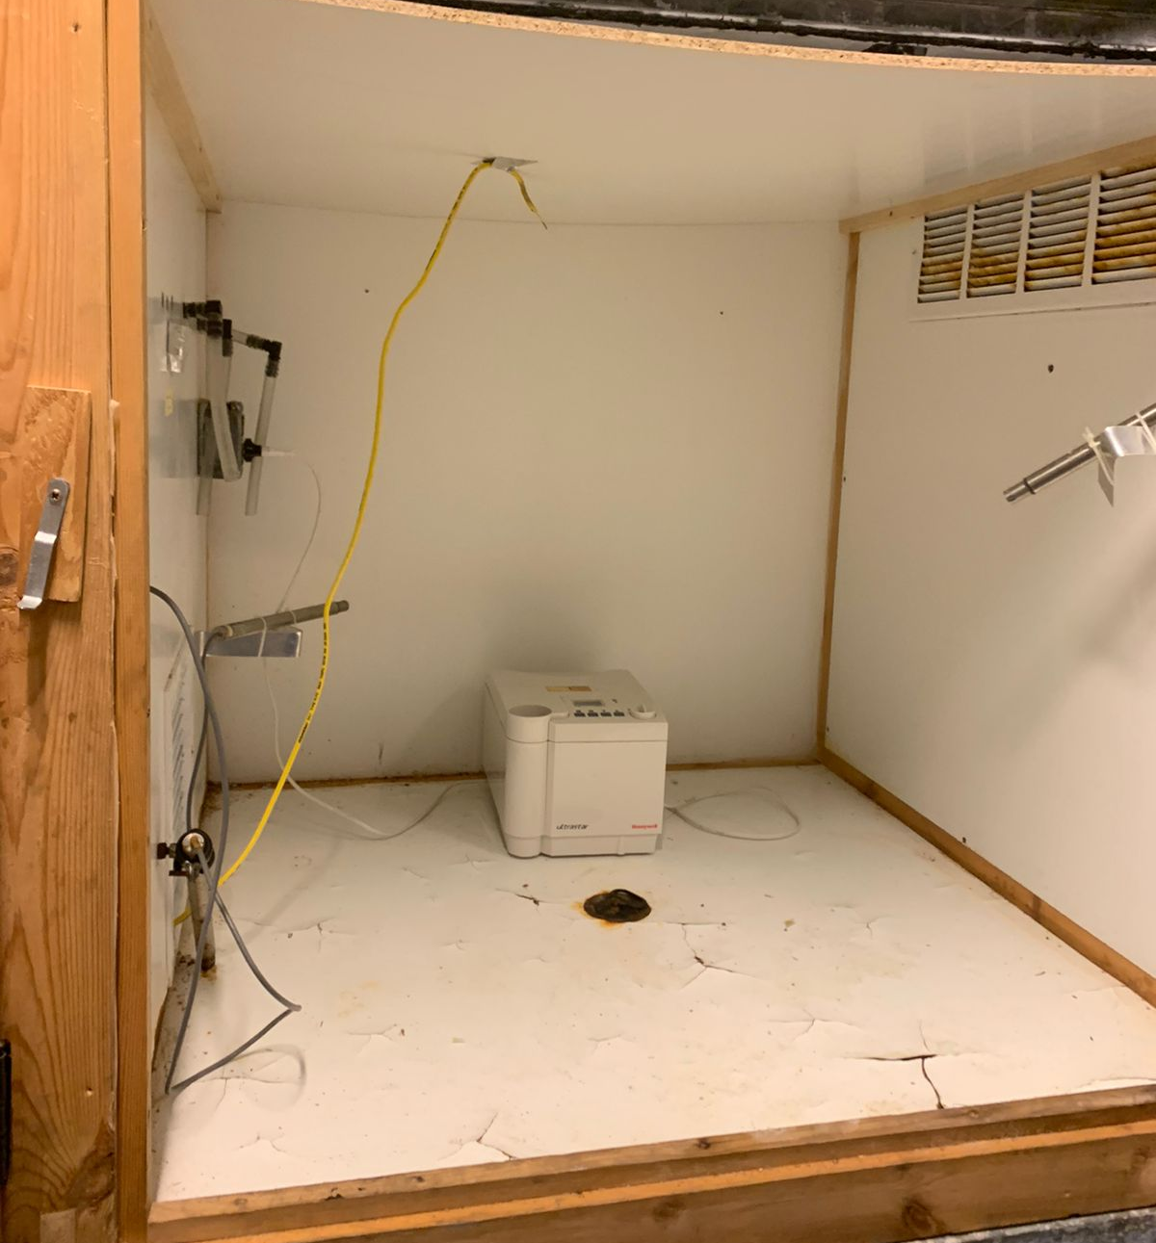


Solar-Assisted Passive Dehumidification System
ⓒ All rights reserved. American University of Beirut 2022.
6. Experimental results
0.8 m x 0.8 m
6.1 Extraction of data
RH and T Dry Bulb
Calculate the Humidity Ratio in every run.
$$P_{sat}=a_{0}+a_{1}T^{1}+a_{2}T^{2}+a_{3}T^{3}+a_{4}T^{4}+a_{5}T^{5}+a_{6}T^{6}$$
$$ω= \frac{0.66 RH P_{sat}}{101 325−RH P_{sat}}×{10}^{3}$$
Notes:
The experimental data obtained using the sensors included the dry bulb temperature and the relative humidity inside the chamber. Since we are interesting in the humidity ratio/ Specific humidity inside the chamber we used the following 6th order polynomial approximation to calculation the saturation pressure and consequently the humidity ratio.

Slide 43
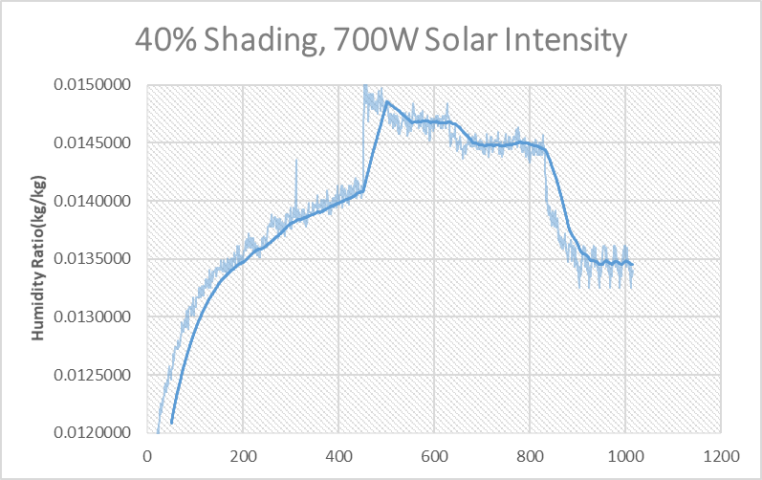
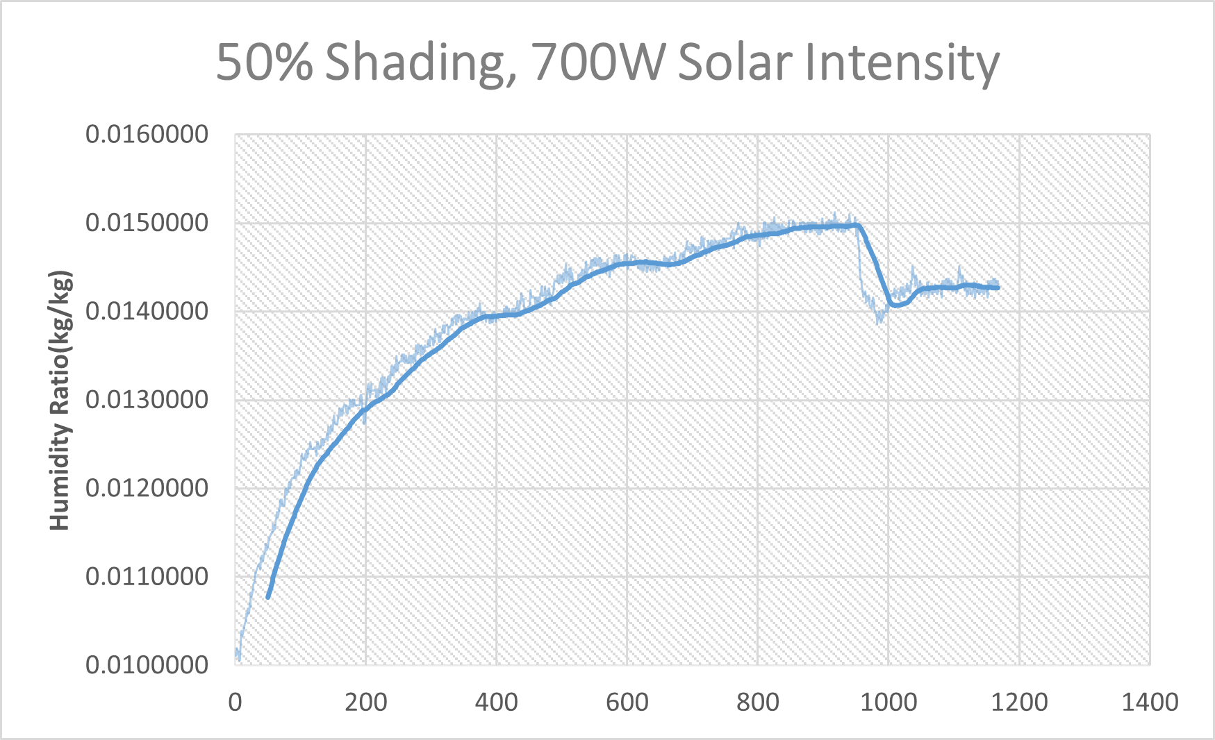
Solar-Assisted Passive Dehumidification System
ⓒ All rights reserved. American University of Beirut 2022.
6. Experimental results
0.8 m x 0.8 m
6.2 analysis of the curves
Sudden drop in humidity
Sudden drop in humidity
Humidification
Dehumidification
Dehumidification
Humidification
Notes:
We plotted the humidity ratio as function of time. In the plots, we can distinguish two sections: the humidification due to the increase in humidity because of the humidifier at the inlet. After reaching steady state and the removal of the aluminum sheet, there is a drop in the humidity due to the dehumidification by the desiccant. However in the first graph, we notice there is a sudden drop in the humidity ratio, and it is for experimental reasons : we wanted to reach steady state faster, so we shut the humidifier for a short period.
We plotted the humidity ratio as a function of time as shown here. We can distinguish 2 sections the humidification and the dehumidification sections. The sudden drop in humidity is due to the turning off of the humidifier in order to accelerate reaching steady state.

Slide 44
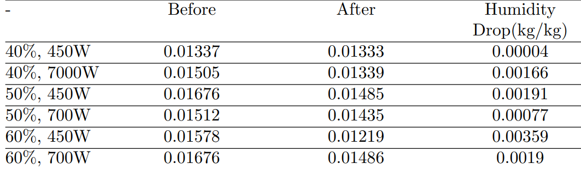
Solar-Assisted Passive Dehumidification System
ⓒ All rights reserved. American University of Beirut 2022.
6. Experimental results
0.8 m x 0.8 m
6.3 tabulated data
For the total of 6 runs we compared the humidity ratio before removing the aluminum sheet and at the end of the experiment.
The highest humidity drop was in the case 60% shading, 450W Solar intensity
Notes:
The humidity ratio values of the 6 runs are tabulated here. Since the steady state data varies in each experiment, we considered the start of the dehumidification, the value of humidity ratio at the instant of removing the aluminum sheet. The final value however, is the steady state humidity ratio at the end of the experiment. We notice that the highest drop of humidity ratio is in the condition of 60% shading and 450W solar intensity. This can be attributed to the lower temperature of the desiccant in the adsorption section of the belt, resulting in more adsorption.

Slide 45
Solar-Assisted Passive Dehumidification System
ⓒ All rights reserved. American University of Beirut 2022.
6. Experimental results
0.8 m x 0.8 m
6.4 Sustainability
Energy consumption: the system consumes less energy than the traditional dehumidification systems
Space: the system can be included in the building façade and does not consume space
Notes:
This system’s advantages are its energy efficiency, since it removes humidity using less energy than indirect dehumidification methods needing only electricity for the motor and the fans.
And the space for the system to be installed can be in a buildings façade.

Slide 46

Thank you

